Slide 1
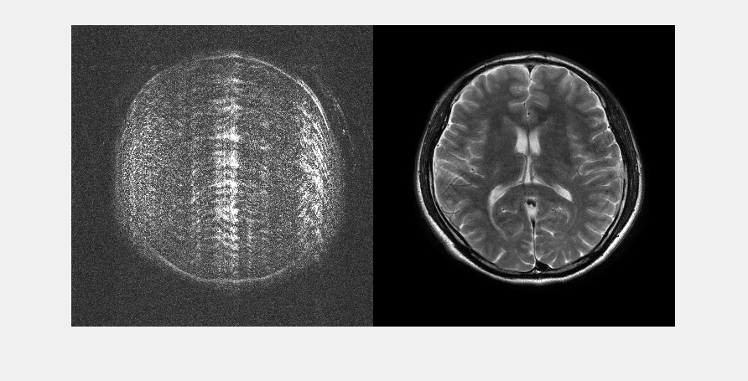
slice_10_mask_4_rank_38.mat Left: Reconstruction error x10, Right: SAKE+ESPIRiT reconstruction
Notes:
Notes data: slide number 1

Slide 2

slice_10_mask_4_rank_40.mat Left: Reconstruction error x10, Right: SAKE+ESPIRiT reconstruction
Notes:
Notes data: slide number 2

Slide 3

slice_10_mask_4_rank_41.mat Left: Reconstruction error x10, Right: SAKE+ESPIRiT reconstruction
Notes:
Notes data: slide number 3

Slide 4

slice_10_mask_4_rank_42.mat Left: Reconstruction error x10, Right: SAKE+ESPIRiT reconstruction
Notes:
Notes data: slide number 4

Slide 5

slice_10_mask_4_rank_44.mat Left: Reconstruction error x10, Right: SAKE+ESPIRiT reconstruction
Notes:
Notes data: slide number 5

Slide 6

slice_10_mask_4_rank_46.mat Left: Reconstruction error x10, Right: SAKE+ESPIRiT reconstruction
Notes:
Notes data: slide number 6

Slide 7

slice_10_mask_4_rank_47.mat Left: Reconstruction error x10, Right: SAKE+ESPIRiT reconstruction
Notes:
Notes data: slide number 7

Slide 8
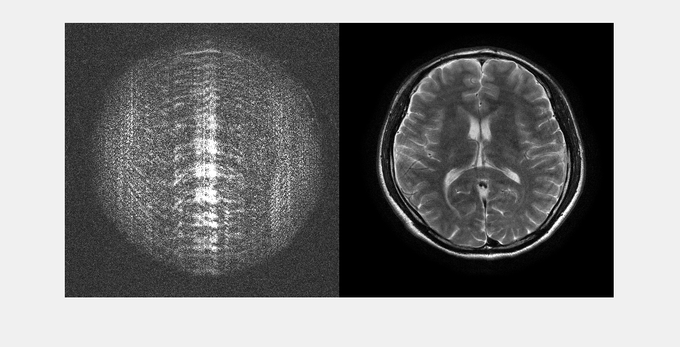
slice_10_mask_4_rank_50.mat Left: Reconstruction error x10, Right: SAKE+ESPIRiT reconstruction
Notes:
Notes data: slide number 8

Slide 9
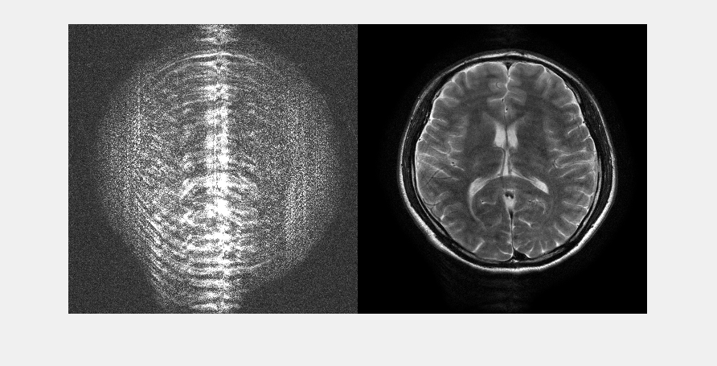
slice_10_mask_4_rank_55.mat Left: Reconstruction error x10, Right: SAKE+ESPIRiT reconstruction
Notes:
Notes data: slide number 9

Slide 10
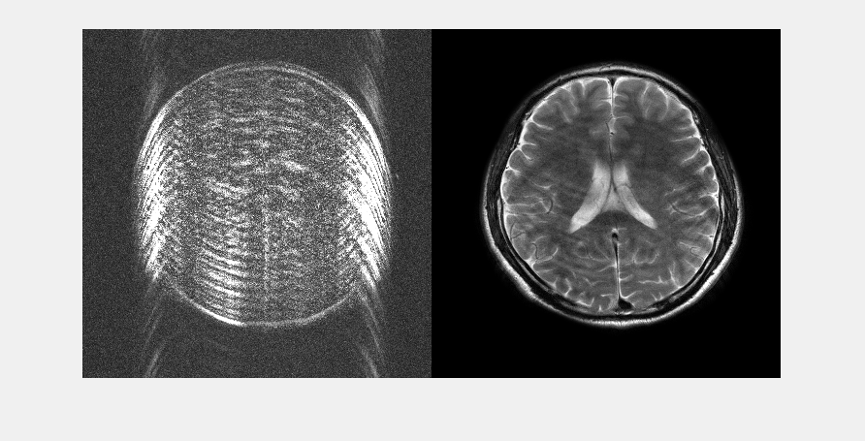
slice_11_mask_4_rank_34.mat Left: Reconstruction error x10, Right: SAKE+ESPIRiT reconstruction
Notes:
Notes data: slide number 10

Slide 11

slice_11_mask_4_rank_38.mat Left: Reconstruction error x10, Right: SAKE+ESPIRiT reconstruction
Notes:
Notes data: slide number 11

Slide 12

slice_11_mask_4_rank_39.mat Left: Reconstruction error x10, Right: SAKE+ESPIRiT reconstruction
Notes:
Notes data: slide number 12

Slide 13

slice_11_mask_4_rank_40.mat Left: Reconstruction error x10, Right: SAKE+ESPIRiT reconstruction
Notes:
Notes data: slide number 13

Slide 14

slice_11_mask_4_rank_41.mat Left: Reconstruction error x10, Right: SAKE+ESPIRiT reconstruction
Notes:
Notes data: slide number 14

Slide 15

slice_11_mask_4_rank_43.mat Left: Reconstruction error x10, Right: SAKE+ESPIRiT reconstruction
Notes:
Notes data: slide number 15

Slide 16

slice_11_mask_4_rank_46.mat Left: Reconstruction error x10, Right: SAKE+ESPIRiT reconstruction
Notes:
Notes data: slide number 16

Slide 17
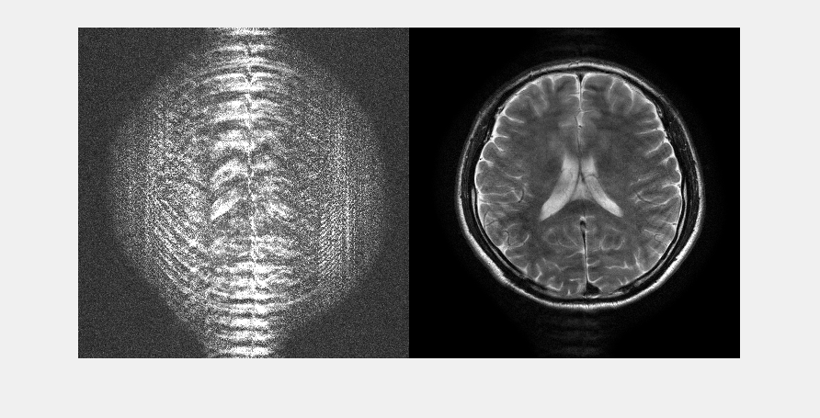
slice_11_mask_4_rank_54.mat Left: Reconstruction error x10, Right: SAKE+ESPIRiT reconstruction
Notes:
Notes data: slide number 17

Slide 18
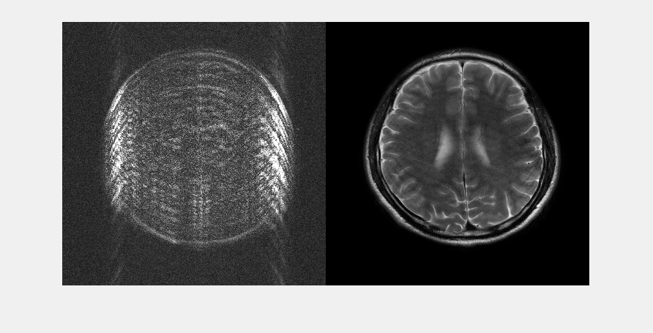
slice_12_mask_4_rank_34.mat Left: Reconstruction error x10, Right: SAKE+ESPIRiT reconstruction
Notes:
Notes data: slide number 18

Slide 19
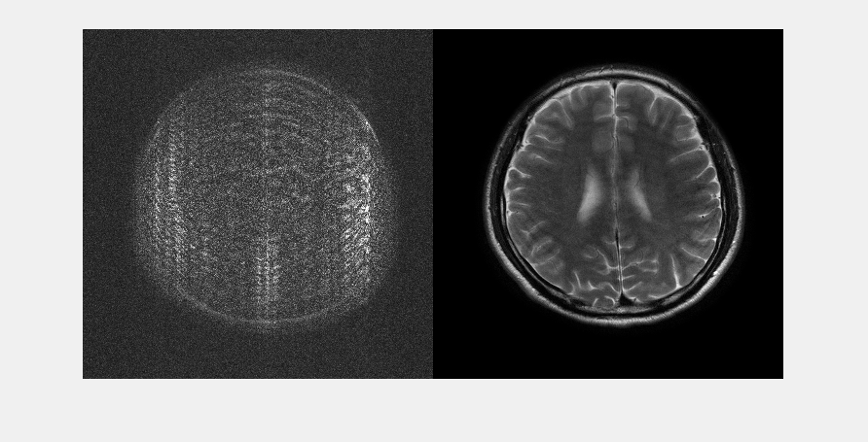
slice_12_mask_4_rank_38.mat Left: Reconstruction error x10, Right: SAKE+ESPIRiT reconstruction
Notes:
Notes data: slide number 19

Slide 20

slice_12_mask_4_rank_39.mat Left: Reconstruction error x10, Right: SAKE+ESPIRiT reconstruction
Notes:
Notes data: slide number 20

Slide 21

slice_12_mask_4_rank_40.mat Left: Reconstruction error x10, Right: SAKE+ESPIRiT reconstruction
Notes:
Notes data: slide number 21

Slide 22

slice_12_mask_4_rank_41.mat Left: Reconstruction error x10, Right: SAKE+ESPIRiT reconstruction
Notes:
Notes data: slide number 22

Slide 23

slice_12_mask_4_rank_43.mat Left: Reconstruction error x10, Right: SAKE+ESPIRiT reconstruction
Notes:
Notes data: slide number 23

Slide 24

slice_12_mask_4_rank_44.mat Left: Reconstruction error x10, Right: SAKE+ESPIRiT reconstruction
Notes:
Notes data: slide number 24

Slide 25
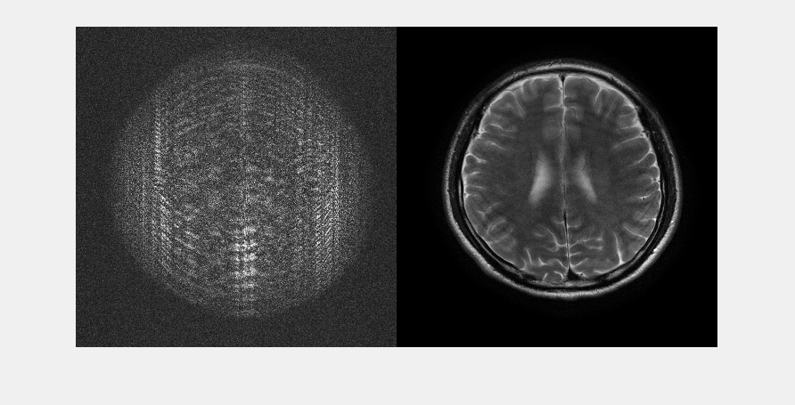
slice_12_mask_4_rank_47.mat Left: Reconstruction error x10, Right: SAKE+ESPIRiT reconstruction
Notes:
Notes data: slide number 25

Slide 26
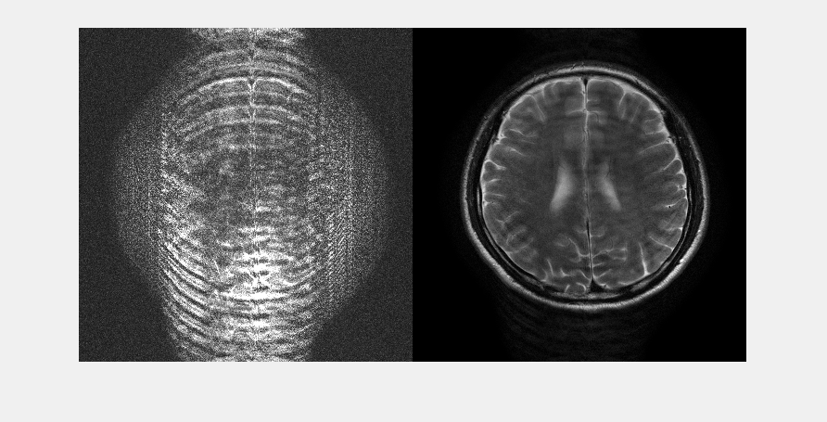
slice_12_mask_4_rank_56.mat Left: Reconstruction error x10, Right: SAKE+ESPIRiT reconstruction
Notes:
Notes data: slide number 26

Slide 27
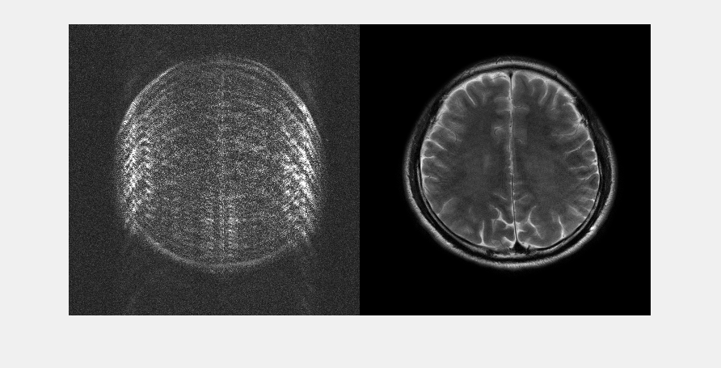
slice_13_mask_4_rank_33.mat Left: Reconstruction error x10, Right: SAKE+ESPIRiT reconstruction
Notes:
Notes data: slide number 27

Slide 28
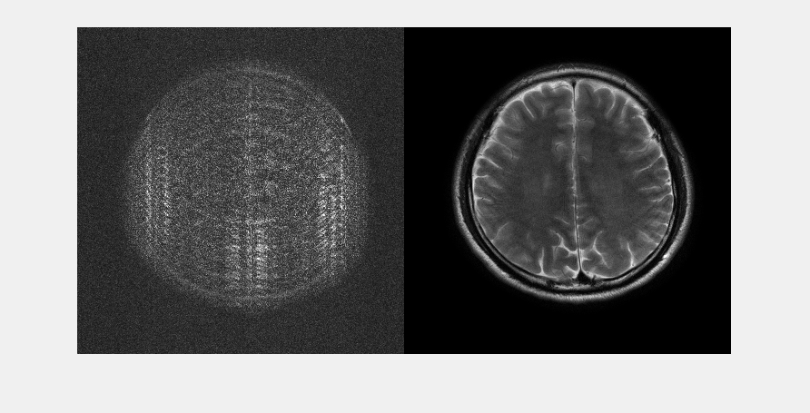
slice_13_mask_4_rank_37.mat Left: Reconstruction error x10, Right: SAKE+ESPIRiT reconstruction
Notes:
Notes data: slide number 28

Slide 29

slice_13_mask_4_rank_38.mat Left: Reconstruction error x10, Right: SAKE+ESPIRiT reconstruction
Notes:
Notes data: slide number 29

Slide 30

slice_13_mask_4_rank_39.mat Left: Reconstruction error x10, Right: SAKE+ESPIRiT reconstruction
Notes:
Notes data: slide number 30

Slide 31

slice_13_mask_4_rank_40.mat Left: Reconstruction error x10, Right: SAKE+ESPIRiT reconstruction
Notes:
Notes data: slide number 31

Slide 32

slice_13_mask_4_rank_42.mat Left: Reconstruction error x10, Right: SAKE+ESPIRiT reconstruction
Notes:
Notes data: slide number 32

Slide 33
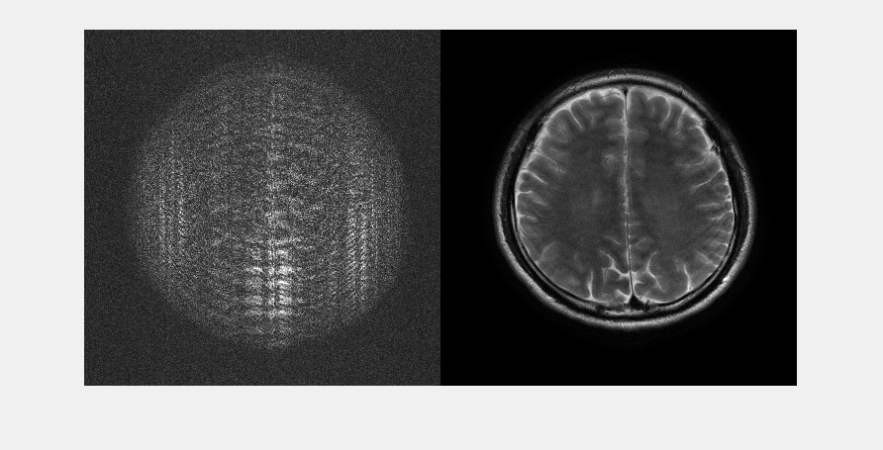
slice_13_mask_4_rank_43.mat Left: Reconstruction error x10, Right: SAKE+ESPIRiT reconstruction
Notes:
Notes data: slide number 33

Slide 34

slice_13_mask_4_rank_45.mat Left: Reconstruction error x10, Right: SAKE+ESPIRiT reconstruction
Notes:
Notes data: slide number 34

Slide 35
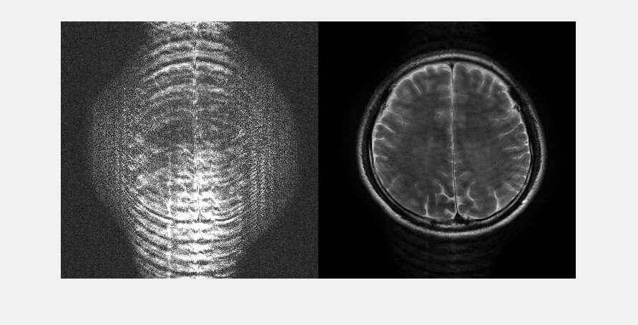
slice_13_mask_4_rank_54.mat Left: Reconstruction error x10, Right: SAKE+ESPIRiT reconstruction
Notes:
Notes data: slide number 35

Slide 36
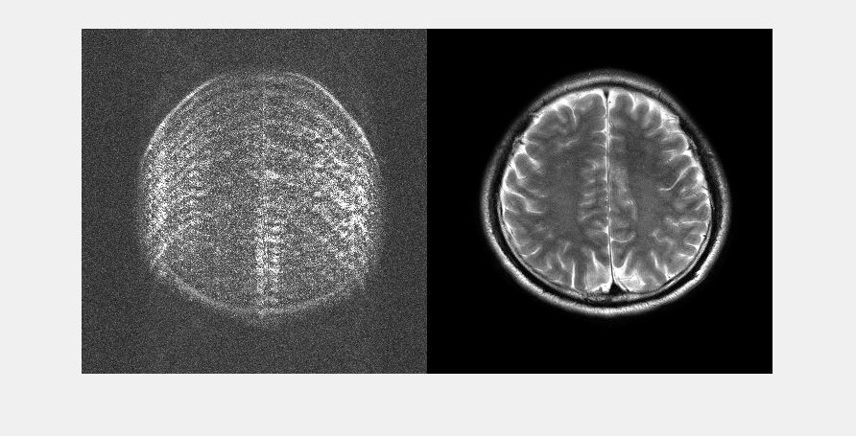
slice_14_mask_4_rank_33.mat Left: Reconstruction error x10, Right: SAKE+ESPIRiT reconstruction
Notes:
Notes data: slide number 36

Slide 37
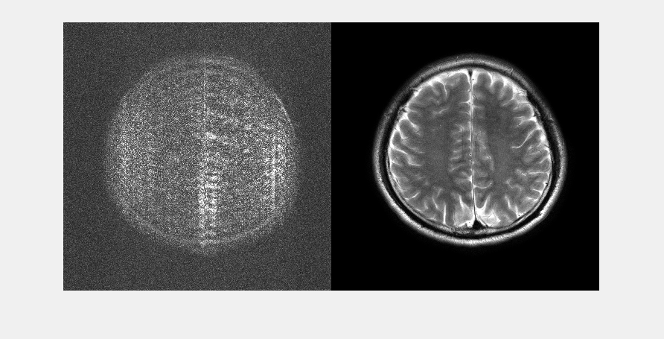
slice_14_mask_4_rank_35.mat Left: Reconstruction error x10, Right: SAKE+ESPIRiT reconstruction
Notes:
Notes data: slide number 37

Slide 38

slice_14_mask_4_rank_36.mat Left: Reconstruction error x10, Right: SAKE+ESPIRiT reconstruction
Notes:
Notes data: slide number 38

Slide 39

slice_14_mask_4_rank_37.mat Left: Reconstruction error x10, Right: SAKE+ESPIRiT reconstruction
Notes:
Notes data: slide number 39

Slide 40

slice_14_mask_4_rank_38.mat Left: Reconstruction error x10, Right: SAKE+ESPIRiT reconstruction
Notes:
Notes data: slide number 40

Slide 41
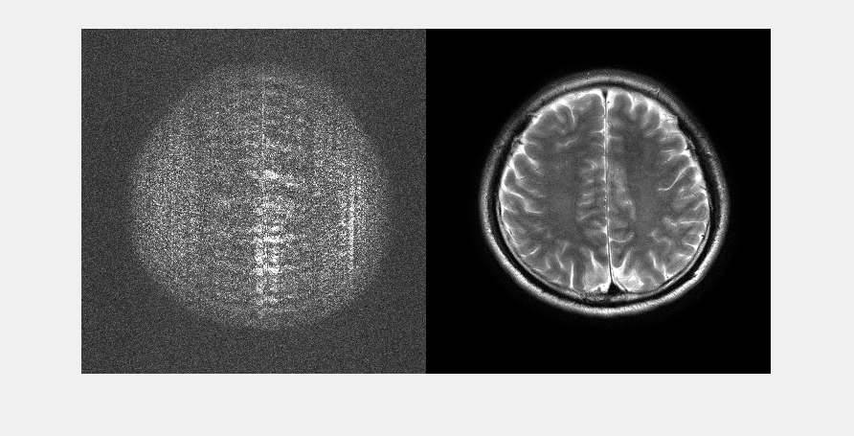
slice_14_mask_4_rank_40.mat Left: Reconstruction error x10, Right: SAKE+ESPIRiT reconstruction
Notes:
Notes data: slide number 41

Slide 42

slice_14_mask_4_rank_43.mat Left: Reconstruction error x10, Right: SAKE+ESPIRiT reconstruction
Notes:
Notes data: slide number 42

Slide 43

slice_14_mask_4_rank_45.mat Left: Reconstruction error x10, Right: SAKE+ESPIRiT reconstruction
Notes:
Notes data: slide number 43

Slide 44
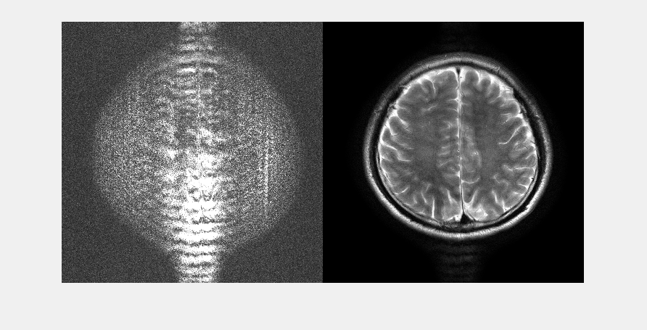
slice_14_mask_4_rank_47.mat Left: Reconstruction error x10, Right: SAKE+ESPIRiT reconstruction
Notes:
Notes data: slide number 44

Slide 45
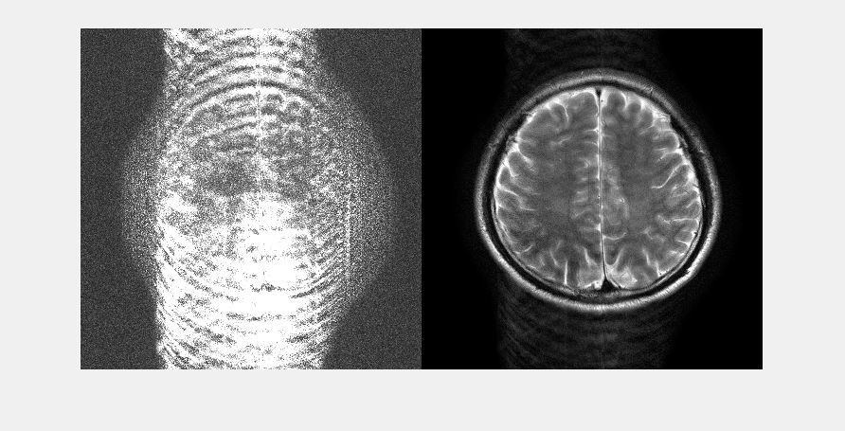
slice_14_mask_4_rank_57.mat Left: Reconstruction error x10, Right: SAKE+ESPIRiT reconstruction
Notes:
Notes data: slide number 45

Slide 46
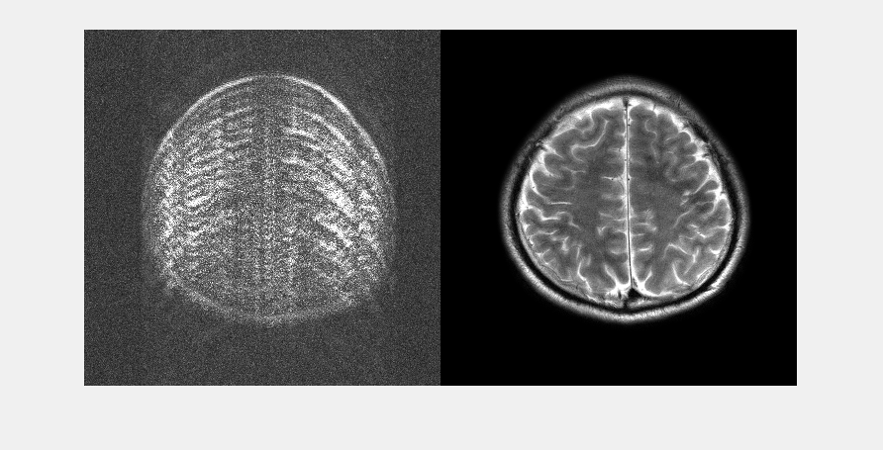
slice_15_mask_4_rank_30.mat Left: Reconstruction error x10, Right: SAKE+ESPIRiT reconstruction
Notes:
Notes data: slide number 46

Slide 47

slice_15_mask_4_rank_34.mat Left: Reconstruction error x10, Right: SAKE+ESPIRiT reconstruction
Notes:
Notes data: slide number 47

Slide 48

slice_15_mask_4_rank_35.mat Left: Reconstruction error x10, Right: SAKE+ESPIRiT reconstruction
Notes:
Notes data: slide number 48

Slide 49

slice_15_mask_4_rank_36.mat Left: Reconstruction error x10, Right: SAKE+ESPIRiT reconstruction
Notes:
Notes data: slide number 49

Slide 50

slice_15_mask_4_rank_37.mat Left: Reconstruction error x10, Right: SAKE+ESPIRiT reconstruction
Notes:
Notes data: slide number 50

Slide 51

slice_15_mask_4_rank_39.mat Left: Reconstruction error x10, Right: SAKE+ESPIRiT reconstruction
Notes:
Notes data: slide number 51

Slide 52

slice_15_mask_4_rank_40.mat Left: Reconstruction error x10, Right: SAKE+ESPIRiT reconstruction
Notes:
Notes data: slide number 52

Slide 53
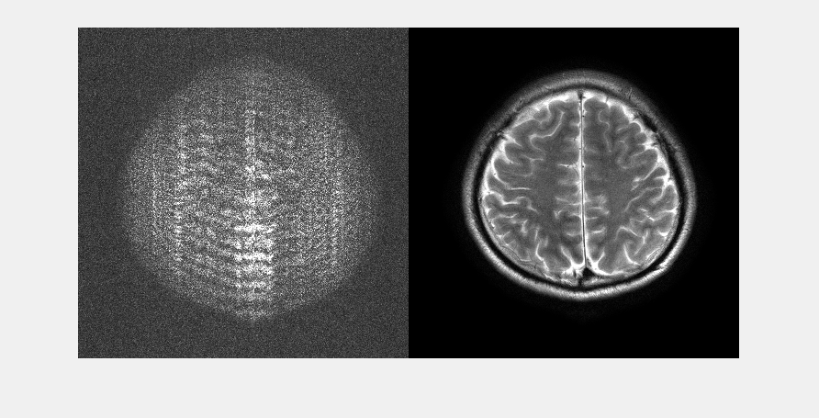
slice_15_mask_4_rank_42.mat Left: Reconstruction error x10, Right: SAKE+ESPIRiT reconstruction
Notes:
Notes data: slide number 53

Slide 54
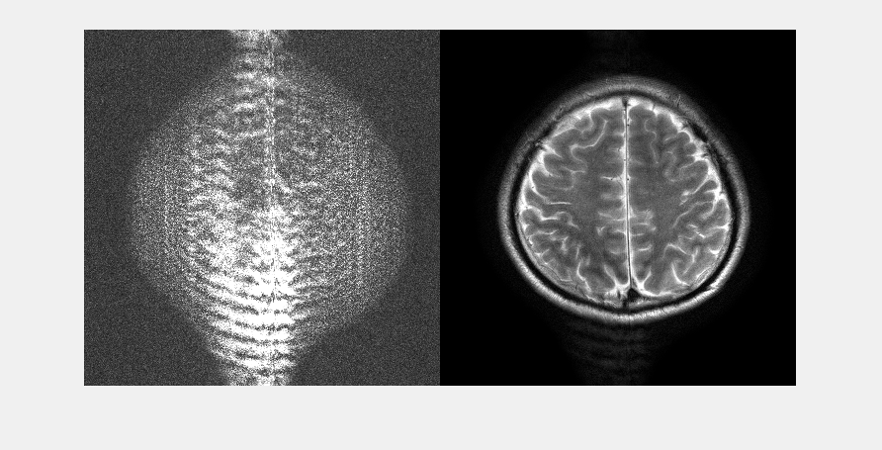
slice_15_mask_4_rank_47.mat Left: Reconstruction error x10, Right: SAKE+ESPIRiT reconstruction
Notes:
Notes data: slide number 54

Slide 55
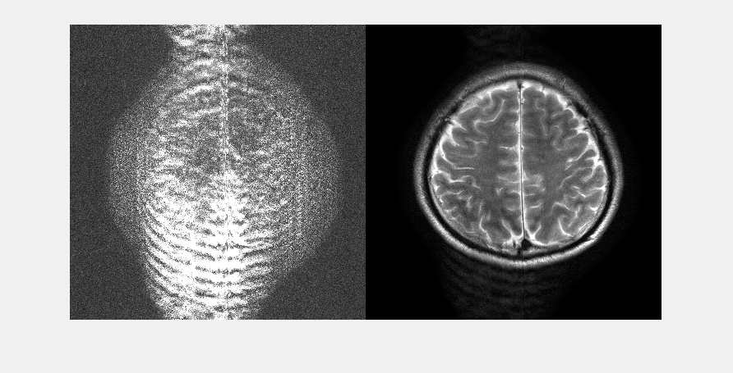
slice_15_mask_4_rank_50.mat Left: Reconstruction error x10, Right: SAKE+ESPIRiT reconstruction
Notes:
Notes data: slide number 55

Slide 56
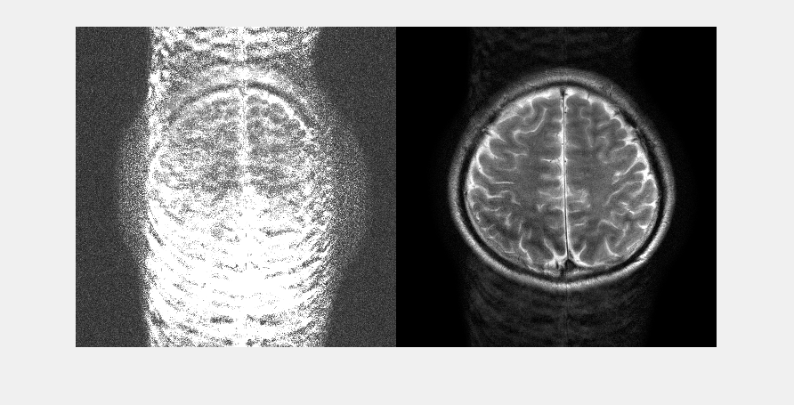
slice_15_mask_4_rank_61.mat Left: Reconstruction error x10, Right: SAKE+ESPIRiT reconstruction
Notes:
Notes data: slide number 56

Slide 57
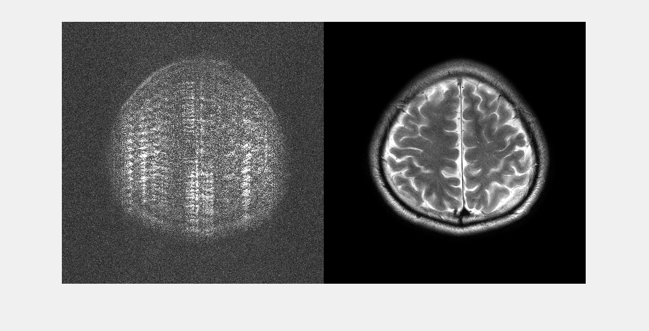
slice_16_mask_4_rank_31.mat Left: Reconstruction error x10, Right: SAKE+ESPIRiT reconstruction
Notes:
Notes data: slide number 57

Slide 58

slice_16_mask_4_rank_33.mat Left: Reconstruction error x10, Right: SAKE+ESPIRiT reconstruction
Notes:
Notes data: slide number 58

Slide 59

slice_16_mask_4_rank_34.mat Left: Reconstruction error x10, Right: SAKE+ESPIRiT reconstruction
Notes:
Notes data: slide number 59

Slide 60

slice_16_mask_4_rank_35.mat Left: Reconstruction error x10, Right: SAKE+ESPIRiT reconstruction
Notes:
Notes data: slide number 60

Slide 61

slice_16_mask_4_rank_36.mat Left: Reconstruction error x10, Right: SAKE+ESPIRiT reconstruction
Notes:
Notes data: slide number 61

Slide 62

slice_16_mask_4_rank_38.mat Left: Reconstruction error x10, Right: SAKE+ESPIRiT reconstruction
Notes:
Notes data: slide number 62

Slide 63

slice_16_mask_4_rank_41.mat Left: Reconstruction error x10, Right: SAKE+ESPIRiT reconstruction
Notes:
Notes data: slide number 63

Slide 64
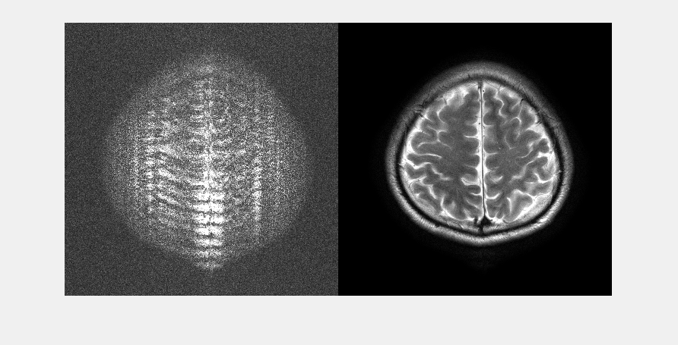
slice_16_mask_4_rank_42.mat Left: Reconstruction error x10, Right: SAKE+ESPIRiT reconstruction
Notes:
Notes data: slide number 64

Slide 65
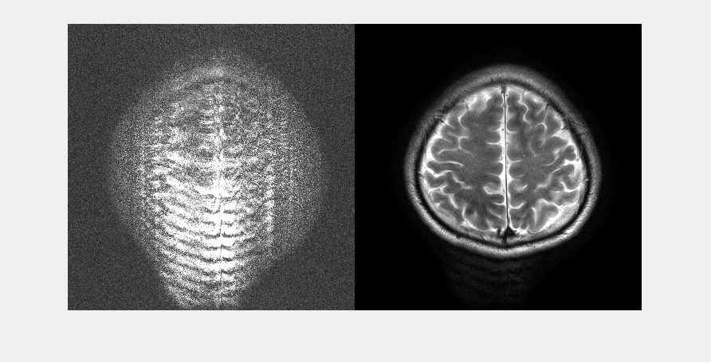
slice_16_mask_4_rank_45.mat Left: Reconstruction error x10, Right: SAKE+ESPIRiT reconstruction
Notes:
Notes data: slide number 65

Slide 66
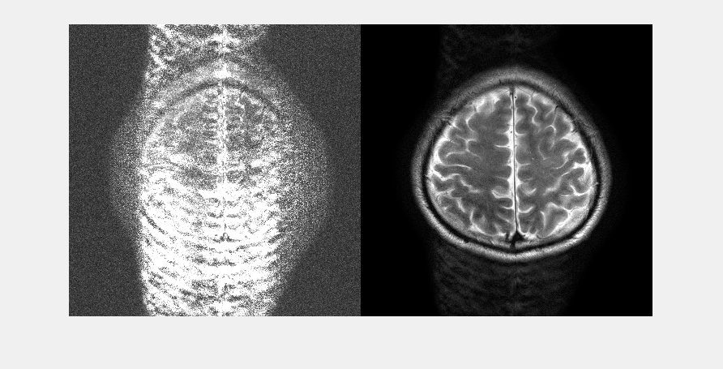
slice_16_mask_4_rank_51.mat Left: Reconstruction error x10, Right: SAKE+ESPIRiT reconstruction
Notes:
Notes data: slide number 66

Slide 67
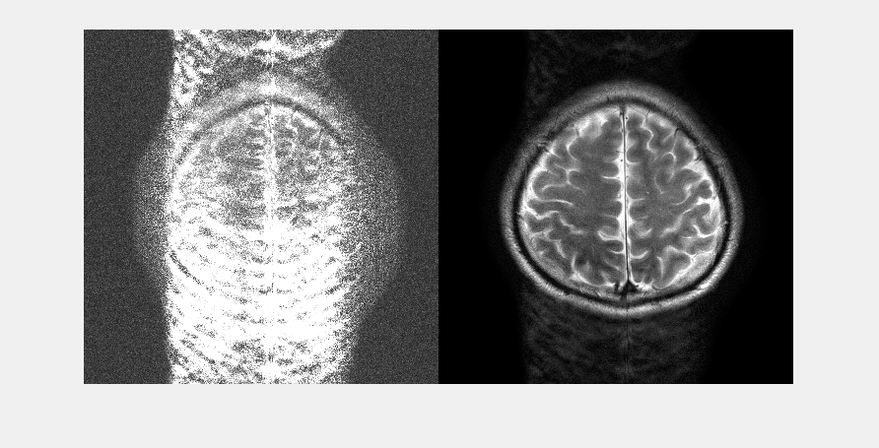
slice_16_mask_4_rank_55.mat Left: Reconstruction error x10, Right: SAKE+ESPIRiT reconstruction
Notes:
Notes data: slide number 67

Slide 68
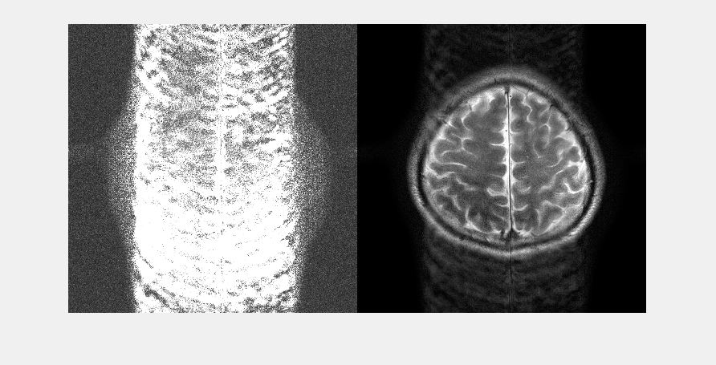
slice_16_mask_4_rank_68.mat Left: Reconstruction error x10, Right: SAKE+ESPIRiT reconstruction
Notes:
Notes data: slide number 68

Slide 69
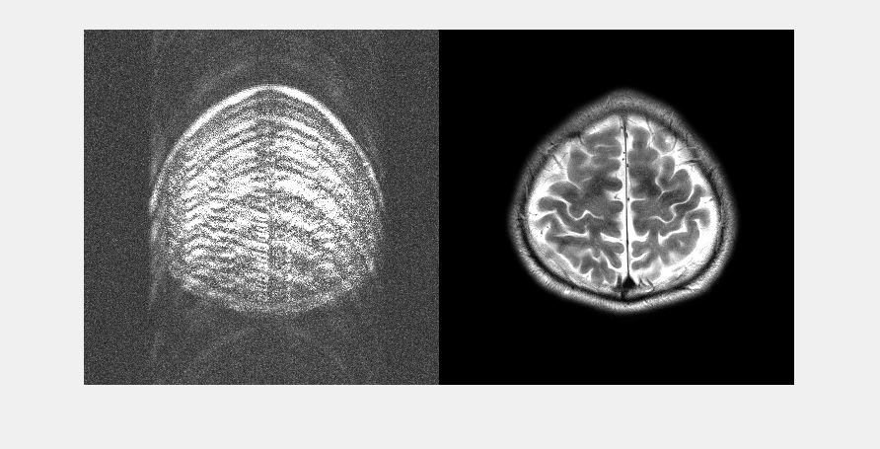
slice_17_mask_4_rank_25.mat Left: Reconstruction error x10, Right: SAKE+ESPIRiT reconstruction
Notes:
Notes data: slide number 69

Slide 70
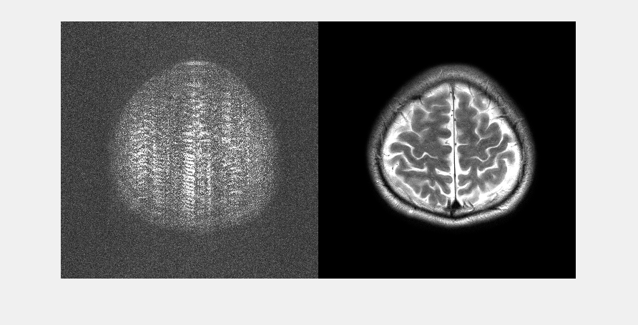
slice_17_mask_4_rank_29.mat Left: Reconstruction error x10, Right: SAKE+ESPIRiT reconstruction
Notes:
Notes data: slide number 70

Slide 71

slice_17_mask_4_rank_30.mat Left: Reconstruction error x10, Right: SAKE+ESPIRiT reconstruction
Notes:
Notes data: slide number 71

Slide 72

slice_17_mask_4_rank_31.mat Left: Reconstruction error x10, Right: SAKE+ESPIRiT reconstruction
Notes:
Notes data: slide number 72

Slide 73

slice_17_mask_4_rank_32.mat Left: Reconstruction error x10, Right: SAKE+ESPIRiT reconstruction
Notes:
Notes data: slide number 73

Slide 74

slice_17_mask_4_rank_33.mat Left: Reconstruction error x10, Right: SAKE+ESPIRiT reconstruction
Notes:
Notes data: slide number 74

Slide 75

slice_17_mask_4_rank_35.mat Left: Reconstruction error x10, Right: SAKE+ESPIRiT reconstruction
Notes:
Notes data: slide number 75

Slide 76
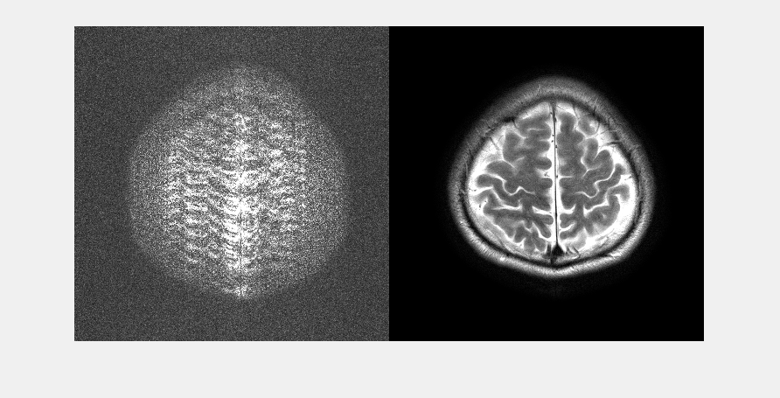
slice_17_mask_4_rank_39.mat Left: Reconstruction error x10, Right: SAKE+ESPIRiT reconstruction
Notes:
Notes data: slide number 76

Slide 77
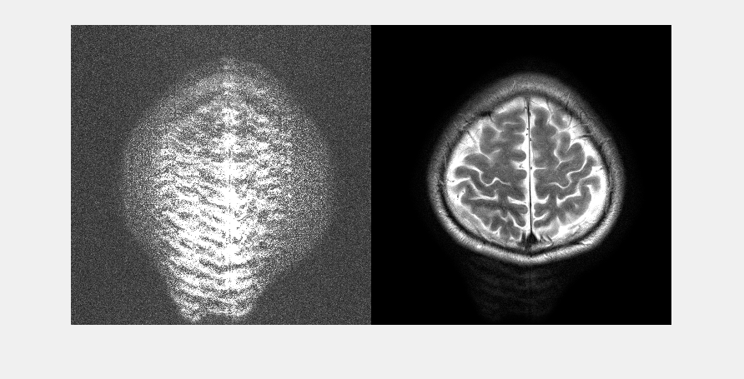
slice_17_mask_4_rank_42.mat Left: Reconstruction error x10, Right: SAKE+ESPIRiT reconstruction
Notes:
Notes data: slide number 77

Slide 78
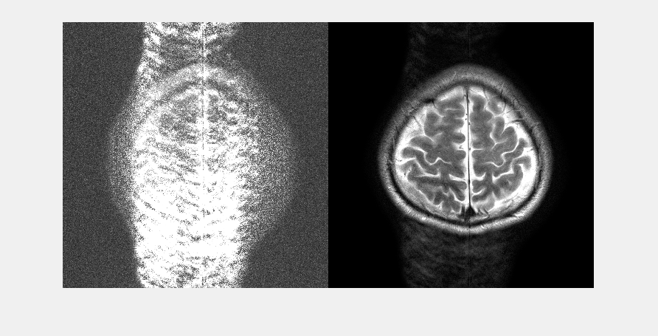
slice_17_mask_4_rank_47.mat Left: Reconstruction error x10, Right: SAKE+ESPIRiT reconstruction
Notes:
Notes data: slide number 78

Slide 79
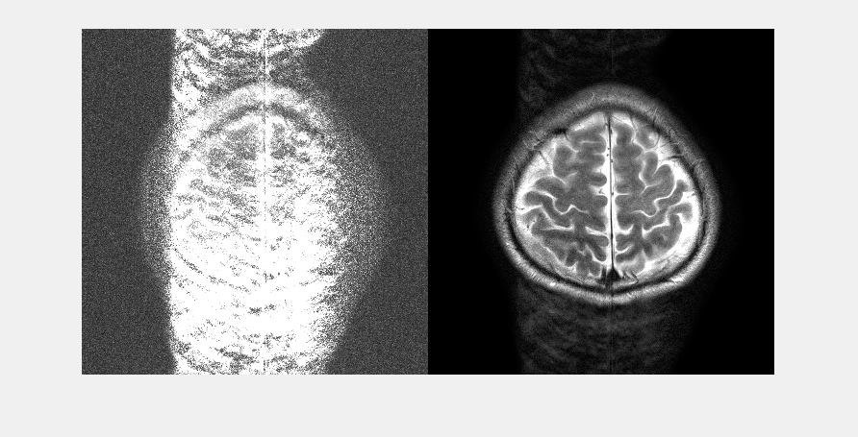
slice_17_mask_4_rank_51.mat Left: Reconstruction error x10, Right: SAKE+ESPIRiT reconstruction
Notes:
Notes data: slide number 79

Slide 80
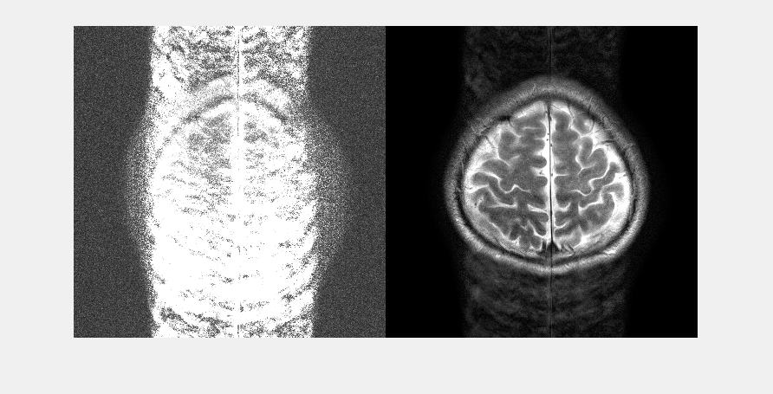
slice_17_mask_4_rank_58.mat Left: Reconstruction error x10, Right: SAKE+ESPIRiT reconstruction
Notes:
Notes data: slide number 80

Slide 81
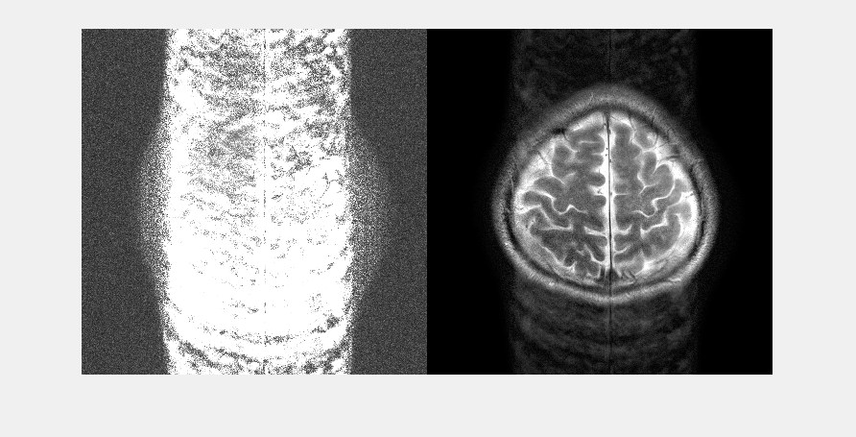
slice_17_mask_4_rank_63.mat Left: Reconstruction error x10, Right: SAKE+ESPIRiT reconstruction
Notes:
Notes data: slide number 81

Slide 82
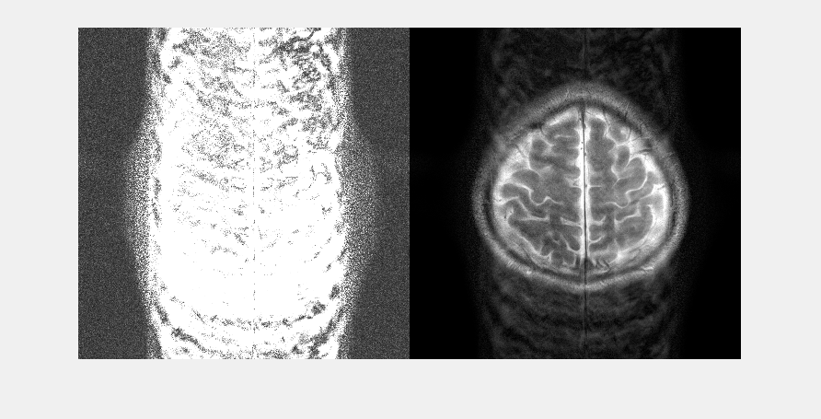
slice_17_mask_4_rank_79.mat Left: Reconstruction error x10, Right: SAKE+ESPIRiT reconstruction
Notes:
Notes data: slide number 82

Slide 83
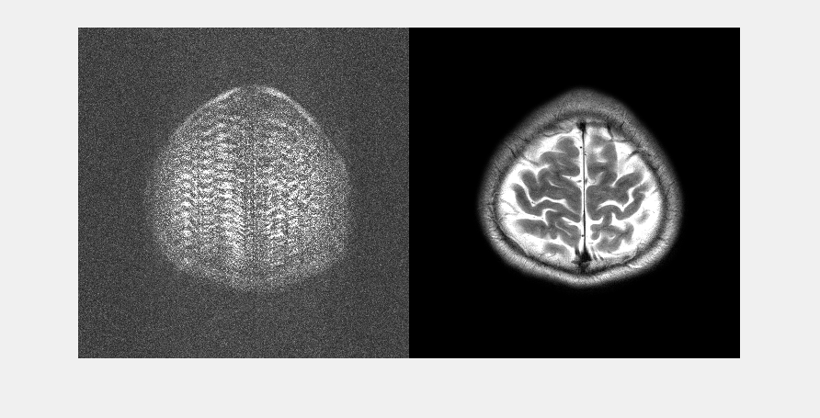
slice_18_mask_4_rank_25.mat Left: Reconstruction error x10, Right: SAKE+ESPIRiT reconstruction
Notes:
Notes data: slide number 83

Slide 84

slice_18_mask_4_rank_27.mat Left: Reconstruction error x10, Right: SAKE+ESPIRiT reconstruction
Notes:
Notes data: slide number 84

Slide 85

slice_18_mask_4_rank_28.mat Left: Reconstruction error x10, Right: SAKE+ESPIRiT reconstruction
Notes:
Notes data: slide number 85

Slide 86

slice_18_mask_4_rank_29.mat Left: Reconstruction error x10, Right: SAKE+ESPIRiT reconstruction
Notes:
Notes data: slide number 86

Slide 87

slice_18_mask_4_rank_30.mat Left: Reconstruction error x10, Right: SAKE+ESPIRiT reconstruction
Notes:
Notes data: slide number 87

Slide 88

slice_18_mask_4_rank_32.mat Left: Reconstruction error x10, Right: SAKE+ESPIRiT reconstruction
Notes:
Notes data: slide number 88

Slide 89

slice_18_mask_4_rank_33.mat Left: Reconstruction error x10, Right: SAKE+ESPIRiT reconstruction
Notes:
Notes data: slide number 89

Slide 90

slice_18_mask_4_rank_35.mat Left: Reconstruction error x10, Right: SAKE+ESPIRiT reconstruction
Notes:
Notes data: slide number 90

Slide 91
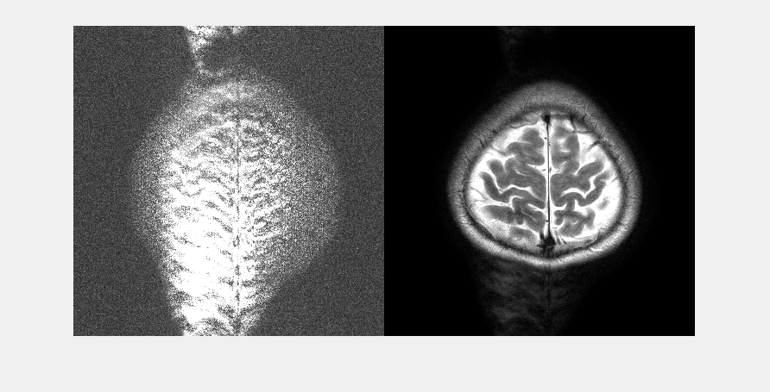
slice_18_mask_4_rank_40.mat Left: Reconstruction error x10, Right: SAKE+ESPIRiT reconstruction
Notes:
Notes data: slide number 91

Slide 92
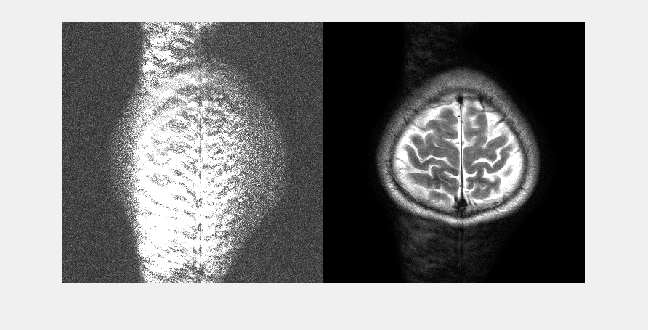
slice_18_mask_4_rank_42.mat Left: Reconstruction error x10, Right: SAKE+ESPIRiT reconstruction
Notes:
Notes data: slide number 92

Slide 93
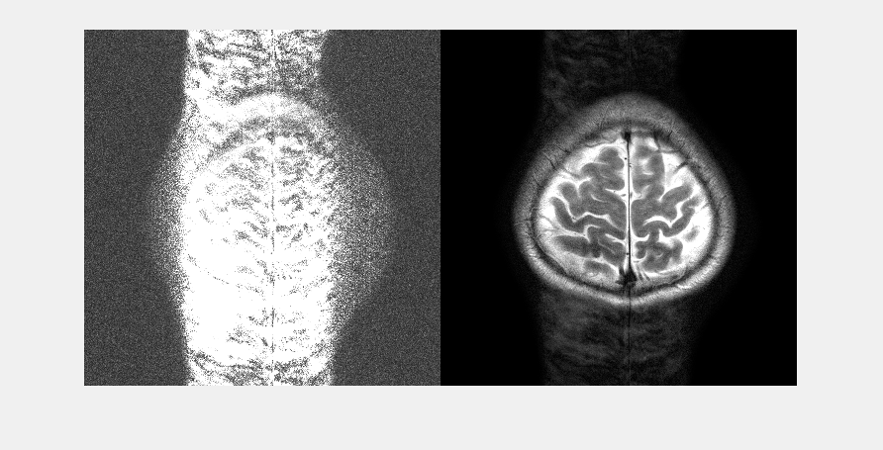
slice_18_mask_4_rank_48.mat Left: Reconstruction error x10, Right: SAKE+ESPIRiT reconstruction
Notes:
Notes data: slide number 93

Slide 94
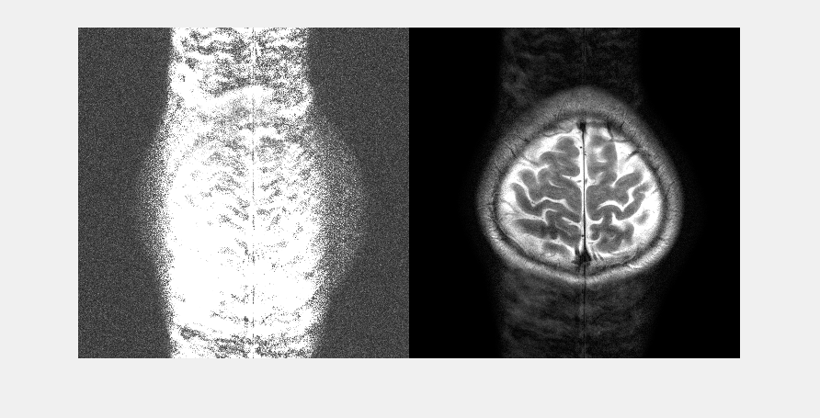
slice_18_mask_4_rank_52.mat Left: Reconstruction error x10, Right: SAKE+ESPIRiT reconstruction
Notes:
Notes data: slide number 94

Slide 95
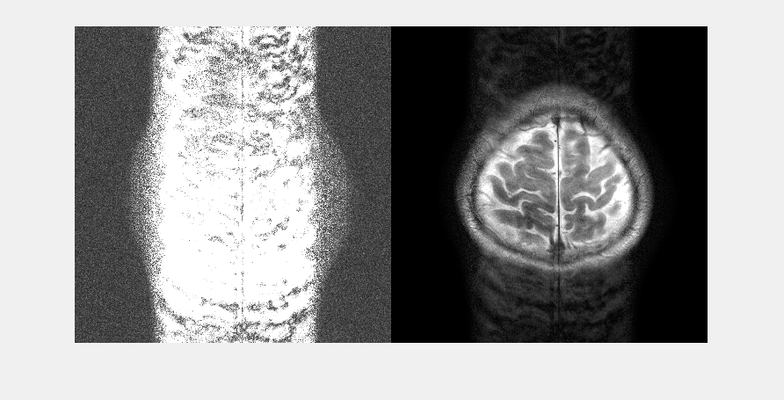
slice_18_mask_4_rank_60.mat Left: Reconstruction error x10, Right: SAKE+ESPIRiT reconstruction
Notes:
Notes data: slide number 95

Slide 96
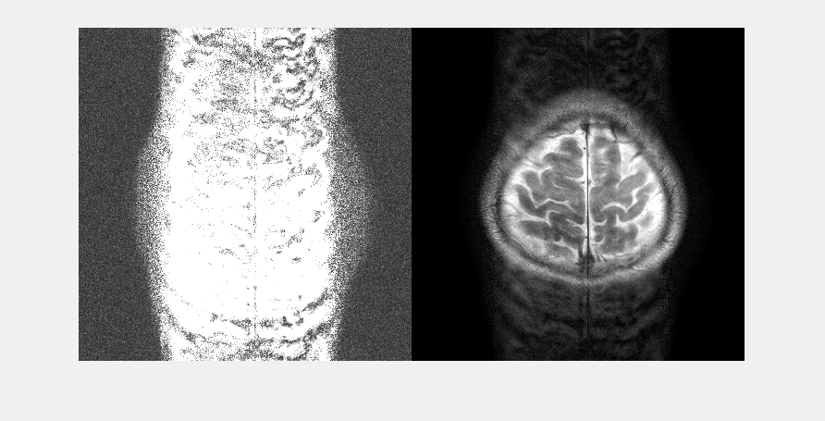
slice_18_mask_4_rank_65.mat Left: Reconstruction error x10, Right: SAKE+ESPIRiT reconstruction
Notes:
Notes data: slide number 96

Slide 97
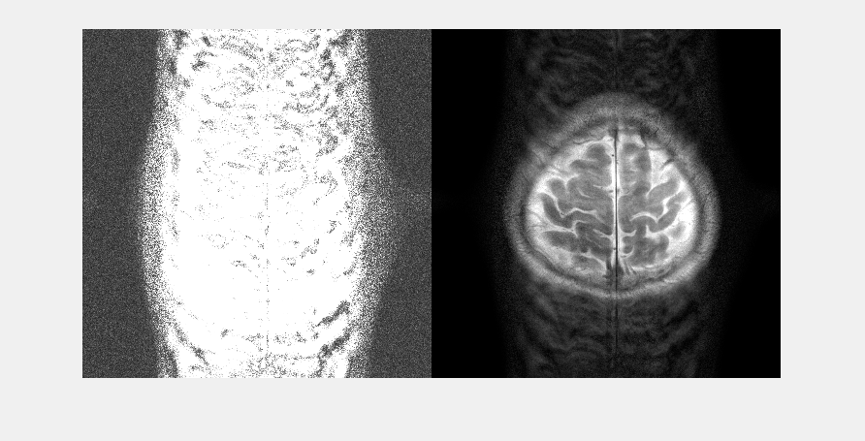
slice_18_mask_4_rank_82.mat Left: Reconstruction error x10, Right: SAKE+ESPIRiT reconstruction
Notes:
Notes data: slide number 97

Slide 98
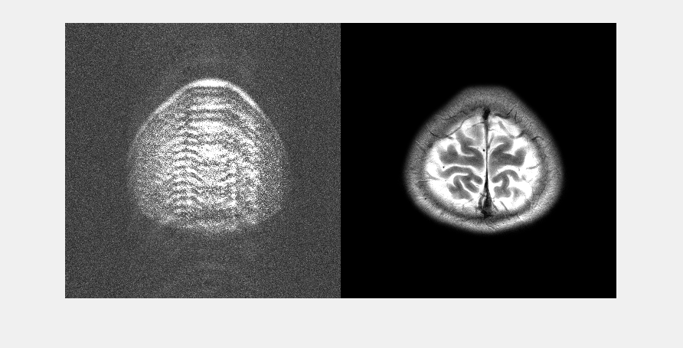
slice_19_mask_4_rank_21.mat Left: Reconstruction error x10, Right: SAKE+ESPIRiT reconstruction
Notes:
Notes data: slide number 98

Slide 99
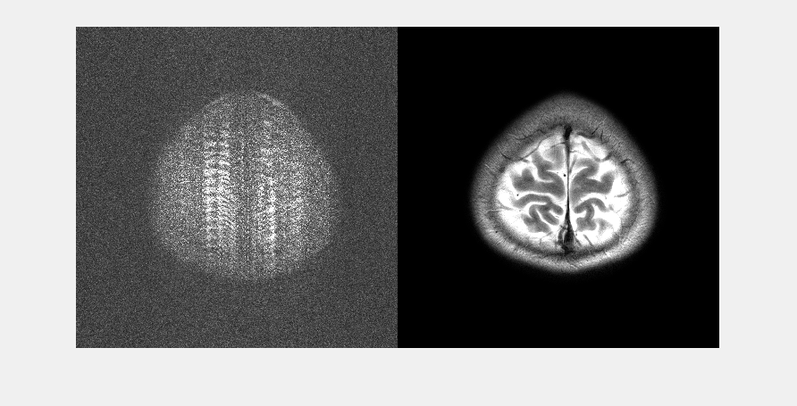
slice_19_mask_4_rank_24.mat Left: Reconstruction error x10, Right: SAKE+ESPIRiT reconstruction
Notes:
Notes data: slide number 99

Slide 100

slice_19_mask_4_rank_25.mat Left: Reconstruction error x10, Right: SAKE+ESPIRiT reconstruction
Notes:
Notes data: slide number 100

Slide 101

slice_19_mask_4_rank_26.mat Left: Reconstruction error x10, Right: SAKE+ESPIRiT reconstruction
Notes:
Notes data: slide number 101

Slide 102

slice_19_mask_4_rank_27.mat Left: Reconstruction error x10, Right: SAKE+ESPIRiT reconstruction
Notes:
Notes data: slide number 102

Slide 103

slice_19_mask_4_rank_28.mat Left: Reconstruction error x10, Right: SAKE+ESPIRiT reconstruction
Notes:
Notes data: slide number 103

Slide 104

slice_19_mask_4_rank_29.mat Left: Reconstruction error x10, Right: SAKE+ESPIRiT reconstruction
Notes:
Notes data: slide number 104

Slide 105
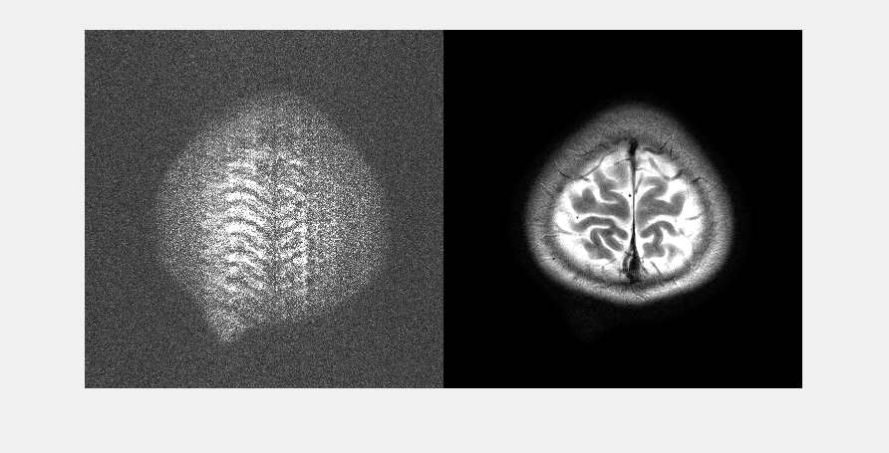
slice_19_mask_4_rank_33.mat Left: Reconstruction error x10, Right: SAKE+ESPIRiT reconstruction
Notes:
Notes data: slide number 105

Slide 106
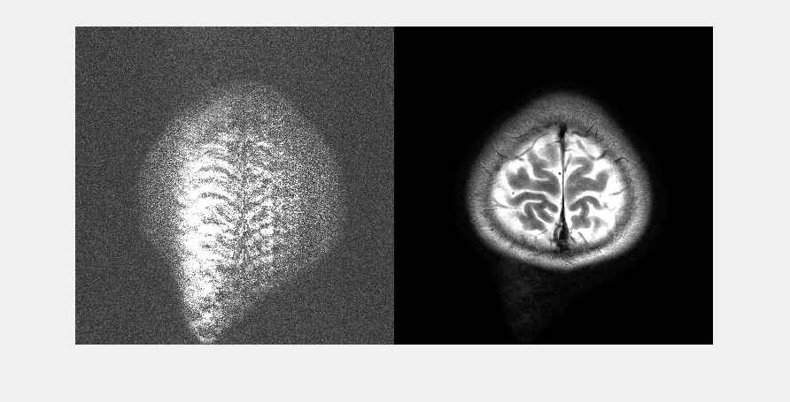
slice_19_mask_4_rank_35.mat Left: Reconstruction error x10, Right: SAKE+ESPIRiT reconstruction
Notes:
Notes data: slide number 106

Slide 107

slice_19_mask_4_rank_40.mat Left: Reconstruction error x10, Right: SAKE+ESPIRiT reconstruction
Notes:
Notes data: slide number 107

Slide 108

slice_19_mask_4_rank_43.mat Left: Reconstruction error x10, Right: SAKE+ESPIRiT reconstruction
Notes:
Notes data: slide number 108

Slide 109

slice_19_mask_4_rank_49.mat Left: Reconstruction error x10, Right: SAKE+ESPIRiT reconstruction
Notes:
Notes data: slide number 109

Slide 110

slice_19_mask_4_rank_53.mat Left: Reconstruction error x10, Right: SAKE+ESPIRiT reconstruction
Notes:
Notes data: slide number 110

Slide 111

slice_19_mask_4_rank_62.mat Left: Reconstruction error x10, Right: SAKE+ESPIRiT reconstruction
Notes:
Notes data: slide number 111

Slide 112

slice_19_mask_4_rank_67.mat Left: Reconstruction error x10, Right: SAKE+ESPIRiT reconstruction
Notes:
Notes data: slide number 112

Slide 113

slice_19_mask_4_rank_86.mat Left: Reconstruction error x10, Right: SAKE+ESPIRiT reconstruction
Notes:
Notes data: slide number 113

Slide 114

slice_1_mask_4_rank_34.mat Left: Reconstruction error x10, Right: SAKE+ESPIRiT reconstruction
Notes:
Notes data: slide number 114

Slide 115

slice_1_mask_4_rank_35.mat Left: Reconstruction error x10, Right: SAKE+ESPIRiT reconstruction
Notes:
Notes data: slide number 115

Slide 116

slice_1_mask_4_rank_36.mat Left: Reconstruction error x10, Right: SAKE+ESPIRiT reconstruction
Notes:
Notes data: slide number 116

Slide 117

slice_1_mask_4_rank_37.mat Left: Reconstruction error x10, Right: SAKE+ESPIRiT reconstruction
Notes:
Notes data: slide number 117

Slide 118

slice_1_mask_4_rank_38.mat Left: Reconstruction error x10, Right: SAKE+ESPIRiT reconstruction
Notes:
Notes data: slide number 118

Slide 119

slice_1_mask_4_rank_40.mat Left: Reconstruction error x10, Right: SAKE+ESPIRiT reconstruction
Notes:
Notes data: slide number 119

Slide 120

slice_1_mask_4_rank_43.mat Left: Reconstruction error x10, Right: SAKE+ESPIRiT reconstruction
Notes:
Notes data: slide number 120

Slide 121

slice_1_mask_4_rank_44.mat Left: Reconstruction error x10, Right: SAKE+ESPIRiT reconstruction
Notes:
Notes data: slide number 121

Slide 122

slice_1_mask_4_rank_46.mat Left: Reconstruction error x10, Right: SAKE+ESPIRiT reconstruction
Notes:
Notes data: slide number 122

Slide 123

slice_1_mask_4_rank_51.mat Left: Reconstruction error x10, Right: SAKE+ESPIRiT reconstruction
Notes:
Notes data: slide number 123

Slide 124

slice_1_mask_4_rank_55.mat Left: Reconstruction error x10, Right: SAKE+ESPIRiT reconstruction
Notes:
Notes data: slide number 124

Slide 125

slice_1_mask_4_rank_66.mat Left: Reconstruction error x10, Right: SAKE+ESPIRiT reconstruction
Notes:
Notes data: slide number 125

Slide 126

slice_20_mask_4_rank_21.mat Left: Reconstruction error x10, Right: SAKE+ESPIRiT reconstruction
Notes:
Notes data: slide number 126

Slide 127

slice_20_mask_4_rank_23.mat Left: Reconstruction error x10, Right: SAKE+ESPIRiT reconstruction
Notes:
Notes data: slide number 127

Slide 128

slice_20_mask_4_rank_24.mat Left: Reconstruction error x10, Right: SAKE+ESPIRiT reconstruction
Notes:
Notes data: slide number 128

Slide 129

slice_20_mask_4_rank_25.mat Left: Reconstruction error x10, Right: SAKE+ESPIRiT reconstruction
Notes:
Notes data: slide number 129

Slide 130

slice_20_mask_4_rank_26.mat Left: Reconstruction error x10, Right: SAKE+ESPIRiT reconstruction
Notes:
Notes data: slide number 130

Slide 131

slice_20_mask_4_rank_28.mat Left: Reconstruction error x10, Right: SAKE+ESPIRiT reconstruction
Notes:
Notes data: slide number 131

Slide 132

slice_20_mask_4_rank_29.mat Left: Reconstruction error x10, Right: SAKE+ESPIRiT reconstruction
Notes:
Notes data: slide number 132

Slide 133

slice_20_mask_4_rank_31.mat Left: Reconstruction error x10, Right: SAKE+ESPIRiT reconstruction
Notes:
Notes data: slide number 133

Slide 134

slice_20_mask_4_rank_35.mat Left: Reconstruction error x10, Right: SAKE+ESPIRiT reconstruction
Notes:
Notes data: slide number 134

Slide 135

slice_20_mask_4_rank_38.mat Left: Reconstruction error x10, Right: SAKE+ESPIRiT reconstruction
Notes:
Notes data: slide number 135

Slide 136

slice_20_mask_4_rank_43.mat Left: Reconstruction error x10, Right: SAKE+ESPIRiT reconstruction
Notes:
Notes data: slide number 136

Slide 137

slice_20_mask_4_rank_47.mat Left: Reconstruction error x10, Right: SAKE+ESPIRiT reconstruction
Notes:
Notes data: slide number 137

Slide 138

slice_20_mask_4_rank_54.mat Left: Reconstruction error x10, Right: SAKE+ESPIRiT reconstruction
Notes:
Notes data: slide number 138

Slide 139

slice_20_mask_4_rank_59.mat Left: Reconstruction error x10, Right: SAKE+ESPIRiT reconstruction
Notes:
Notes data: slide number 139

Slide 140

slice_20_mask_4_rank_69.mat Left: Reconstruction error x10, Right: SAKE+ESPIRiT reconstruction
Notes:
Notes data: slide number 140

Slide 141

slice_20_mask_4_rank_76.mat Left: Reconstruction error x10, Right: SAKE+ESPIRiT reconstruction
Notes:
Notes data: slide number 141

Slide 142

slice_20_mask_4_rank_98.mat Left: Reconstruction error x10, Right: SAKE+ESPIRiT reconstruction
Notes:
Notes data: slide number 142

Slide 143

slice_2_mask_4_rank_34.mat Left: Reconstruction error x10, Right: SAKE+ESPIRiT reconstruction
Notes:
Notes data: slide number 143

Slide 144

slice_2_mask_4_rank_38.mat Left: Reconstruction error x10, Right: SAKE+ESPIRiT reconstruction
Notes:
Notes data: slide number 144

Slide 145

slice_2_mask_4_rank_39.mat Left: Reconstruction error x10, Right: SAKE+ESPIRiT reconstruction
Notes:
Notes data: slide number 145

Slide 146

slice_2_mask_4_rank_42.mat Left: Reconstruction error x10, Right: SAKE+ESPIRiT reconstruction
Notes:
Notes data: slide number 146

Slide 147

slice_2_mask_4_rank_43.mat Left: Reconstruction error x10, Right: SAKE+ESPIRiT reconstruction
Notes:
Notes data: slide number 147

Slide 148

slice_2_mask_4_rank_44.mat Left: Reconstruction error x10, Right: SAKE+ESPIRiT reconstruction
Notes:
Notes data: slide number 148

Slide 149

slice_2_mask_4_rank_45.mat Left: Reconstruction error x10, Right: SAKE+ESPIRiT reconstruction
Notes:
Notes data: slide number 149

Slide 150

slice_2_mask_4_rank_50.mat Left: Reconstruction error x10, Right: SAKE+ESPIRiT reconstruction
Notes:
Notes data: slide number 150

Slide 151

slice_2_mask_4_rank_53.mat Left: Reconstruction error x10, Right: SAKE+ESPIRiT reconstruction
Notes:
Notes data: slide number 151

Slide 152

slice_2_mask_4_rank_63.mat Left: Reconstruction error x10, Right: SAKE+ESPIRiT reconstruction
Notes:
Notes data: slide number 152

Slide 153

slice_3_mask_4_rank_37.mat Left: Reconstruction error x10, Right: SAKE+ESPIRiT reconstruction
Notes:
Notes data: slide number 153

Slide 154

slice_3_mask_4_rank_40.mat Left: Reconstruction error x10, Right: SAKE+ESPIRiT reconstruction
Notes:
Notes data: slide number 154

Slide 155

slice_3_mask_4_rank_41.mat Left: Reconstruction error x10, Right: SAKE+ESPIRiT reconstruction
Notes:
Notes data: slide number 155

Slide 156

slice_3_mask_4_rank_42.mat Left: Reconstruction error x10, Right: SAKE+ESPIRiT reconstruction
Notes:
Notes data: slide number 156

Slide 157

slice_3_mask_4_rank_43.mat Left: Reconstruction error x10, Right: SAKE+ESPIRiT reconstruction
Notes:
Notes data: slide number 157

Slide 158

slice_3_mask_4_rank_44.mat Left: Reconstruction error x10, Right: SAKE+ESPIRiT reconstruction
Notes:
Notes data: slide number 158

Slide 159

slice_3_mask_4_rank_47.mat Left: Reconstruction error x10, Right: SAKE+ESPIRiT reconstruction
Notes:
Notes data: slide number 159

Slide 160

slice_3_mask_4_rank_48.mat Left: Reconstruction error x10, Right: SAKE+ESPIRiT reconstruction
Notes:
Notes data: slide number 160

Slide 161

slice_3_mask_4_rank_51.mat Left: Reconstruction error x10, Right: SAKE+ESPIRiT reconstruction
Notes:
Notes data: slide number 161

Slide 162

slice_3_mask_4_rank_61.mat Left: Reconstruction error x10, Right: SAKE+ESPIRiT reconstruction
Notes:
Notes data: slide number 162

Slide 163

slice_4_mask_4_rank_38.mat Left: Reconstruction error x10, Right: SAKE+ESPIRiT reconstruction
Notes:
Notes data: slide number 163

Slide 164

slice_4_mask_4_rank_41.mat Left: Reconstruction error x10, Right: SAKE+ESPIRiT reconstruction
Notes:
Notes data: slide number 164

Slide 165

slice_4_mask_4_rank_42.mat Left: Reconstruction error x10, Right: SAKE+ESPIRiT reconstruction
Notes:
Notes data: slide number 165

Slide 166

slice_4_mask_4_rank_43.mat Left: Reconstruction error x10, Right: SAKE+ESPIRiT reconstruction
Notes:
Notes data: slide number 166

Slide 167

slice_4_mask_4_rank_44.mat Left: Reconstruction error x10, Right: SAKE+ESPIRiT reconstruction
Notes:
Notes data: slide number 167

Slide 168

slice_4_mask_4_rank_46.mat Left: Reconstruction error x10, Right: SAKE+ESPIRiT reconstruction
Notes:
Notes data: slide number 168

Slide 169

slice_4_mask_4_rank_47.mat Left: Reconstruction error x10, Right: SAKE+ESPIRiT reconstruction
Notes:
Notes data: slide number 169

Slide 170

slice_4_mask_4_rank_50.mat Left: Reconstruction error x10, Right: SAKE+ESPIRiT reconstruction
Notes:
Notes data: slide number 170

Slide 171

slice_4_mask_4_rank_54.mat Left: Reconstruction error x10, Right: SAKE+ESPIRiT reconstruction
Notes:
Notes data: slide number 171

Slide 172

slice_5_mask_4_rank_39.mat Left: Reconstruction error x10, Right: SAKE+ESPIRiT reconstruction
Notes:
Notes data: slide number 172

Slide 173

slice_5_mask_4_rank_42.mat Left: Reconstruction error x10, Right: SAKE+ESPIRiT reconstruction
Notes:
Notes data: slide number 173

Slide 174

slice_5_mask_4_rank_43.mat Left: Reconstruction error x10, Right: SAKE+ESPIRiT reconstruction
Notes:
Notes data: slide number 174

Slide 175

slice_5_mask_4_rank_44.mat Left: Reconstruction error x10, Right: SAKE+ESPIRiT reconstruction
Notes:
Notes data: slide number 175

Slide 176

slice_5_mask_4_rank_45.mat Left: Reconstruction error x10, Right: SAKE+ESPIRiT reconstruction
Notes:
Notes data: slide number 176

Slide 177

slice_5_mask_4_rank_47.mat Left: Reconstruction error x10, Right: SAKE+ESPIRiT reconstruction
Notes:
Notes data: slide number 177

Slide 178

slice_5_mask_4_rank_48.mat Left: Reconstruction error x10, Right: SAKE+ESPIRiT reconstruction
Notes:
Notes data: slide number 178

Slide 179

slice_5_mask_4_rank_51.mat Left: Reconstruction error x10, Right: SAKE+ESPIRiT reconstruction
Notes:
Notes data: slide number 179

Slide 180

slice_5_mask_4_rank_55.mat Left: Reconstruction error x10, Right: SAKE+ESPIRiT reconstruction
Notes:
Notes data: slide number 180

Slide 181

slice_6_mask_4_rank_38.mat Left: Reconstruction error x10, Right: SAKE+ESPIRiT reconstruction
Notes:
Notes data: slide number 181

Slide 182

slice_6_mask_4_rank_41.mat Left: Reconstruction error x10, Right: SAKE+ESPIRiT reconstruction
Notes:
Notes data: slide number 182

Slide 183

slice_6_mask_4_rank_42.mat Left: Reconstruction error x10, Right: SAKE+ESPIRiT reconstruction
Notes:
Notes data: slide number 183

Slide 184

slice_6_mask_4_rank_43.mat Left: Reconstruction error x10, Right: SAKE+ESPIRiT reconstruction
Notes:
Notes data: slide number 184

Slide 185

slice_6_mask_4_rank_44.mat Left: Reconstruction error x10, Right: SAKE+ESPIRiT reconstruction
Notes:
Notes data: slide number 185

Slide 186

slice_6_mask_4_rank_45.mat Left: Reconstruction error x10, Right: SAKE+ESPIRiT reconstruction
Notes:
Notes data: slide number 186

Slide 187

slice_6_mask_4_rank_46.mat Left: Reconstruction error x10, Right: SAKE+ESPIRiT reconstruction
Notes:
Notes data: slide number 187

Slide 188

slice_6_mask_4_rank_49.mat Left: Reconstruction error x10, Right: SAKE+ESPIRiT reconstruction
Notes:
Notes data: slide number 188

Slide 189

slice_6_mask_4_rank_53.mat Left: Reconstruction error x10, Right: SAKE+ESPIRiT reconstruction
Notes:
Notes data: slide number 189

Slide 190

slice_7_mask_4_rank_35.mat Left: Reconstruction error x10, Right: SAKE+ESPIRiT reconstruction
Notes:
Notes data: slide number 190

Slide 191

slice_7_mask_4_rank_39.mat Left: Reconstruction error x10, Right: SAKE+ESPIRiT reconstruction
Notes:
Notes data: slide number 191

Slide 192

slice_7_mask_4_rank_41.mat Left: Reconstruction error x10, Right: SAKE+ESPIRiT reconstruction
Notes:
Notes data: slide number 192

Slide 193

slice_7_mask_4_rank_42.mat Left: Reconstruction error x10, Right: SAKE+ESPIRiT reconstruction
Notes:
Notes data: slide number 193

Slide 194

slice_7_mask_4_rank_43.mat Left: Reconstruction error x10, Right: SAKE+ESPIRiT reconstruction
Notes:
Notes data: slide number 194

Slide 195

slice_7_mask_4_rank_44.mat Left: Reconstruction error x10, Right: SAKE+ESPIRiT reconstruction
Notes:
Notes data: slide number 195

Slide 196

slice_7_mask_4_rank_45.mat Left: Reconstruction error x10, Right: SAKE+ESPIRiT reconstruction
Notes:
Notes data: slide number 196

Slide 197

slice_7_mask_4_rank_47.mat Left: Reconstruction error x10, Right: SAKE+ESPIRiT reconstruction
Notes:
Notes data: slide number 197

Slide 198

slice_7_mask_4_rank_56.mat Left: Reconstruction error x10, Right: SAKE+ESPIRiT reconstruction
Notes:
Notes data: slide number 198

Slide 199

slice_8_mask_4_rank_38.mat Left: Reconstruction error x10, Right: SAKE+ESPIRiT reconstruction
Notes:
Notes data: slide number 199

Slide 200

slice_8_mask_4_rank_39.mat Left: Reconstruction error x10, Right: SAKE+ESPIRiT reconstruction
Notes:
Notes data: slide number 200

Slide 201

slice_8_mask_4_rank_40.mat Left: Reconstruction error x10, Right: SAKE+ESPIRiT reconstruction
Notes:
Notes data: slide number 201

Slide 202

slice_8_mask_4_rank_41.mat Left: Reconstruction error x10, Right: SAKE+ESPIRiT reconstruction
Notes:
Notes data: slide number 202

Slide 203

slice_8_mask_4_rank_42.mat Left: Reconstruction error x10, Right: SAKE+ESPIRiT reconstruction
Notes:
Notes data: slide number 203

Slide 204

slice_8_mask_4_rank_43.mat Left: Reconstruction error x10, Right: SAKE+ESPIRiT reconstruction
Notes:
Notes data: slide number 204

Slide 205

slice_8_mask_4_rank_44.mat Left: Reconstruction error x10, Right: SAKE+ESPIRiT reconstruction
Notes:
Notes data: slide number 205

Slide 206

slice_8_mask_4_rank_45.mat Left: Reconstruction error x10, Right: SAKE+ESPIRiT reconstruction
Notes:
Notes data: slide number 206

Slide 207

slice_8_mask_4_rank_46.mat Left: Reconstruction error x10, Right: SAKE+ESPIRiT reconstruction
Notes:
Notes data: slide number 207

Slide 208

slice_8_mask_4_rank_49.mat Left: Reconstruction error x10, Right: SAKE+ESPIRiT reconstruction
Notes:
Notes data: slide number 208

Slide 209

slice_8_mask_4_rank_53.mat Left: Reconstruction error x10, Right: SAKE+ESPIRiT reconstruction
Notes:
Notes data: slide number 209

Slide 210

slice_9_mask_4_rank_38.mat Left: Reconstruction error x10, Right: SAKE+ESPIRiT reconstruction
Notes:
Notes data: slide number 210

Slide 211

slice_9_mask_4_rank_39.mat Left: Reconstruction error x10, Right: SAKE+ESPIRiT reconstruction
Notes:
Notes data: slide number 211

Slide 212

slice_9_mask_4_rank_40.mat Left: Reconstruction error x10, Right: SAKE+ESPIRiT reconstruction
Notes:
Notes data: slide number 212

Slide 213

slice_9_mask_4_rank_41.mat Left: Reconstruction error x10, Right: SAKE+ESPIRiT reconstruction
Notes:
Notes data: slide number 213

Slide 214

slice_9_mask_4_rank_42.mat Left: Reconstruction error x10, Right: SAKE+ESPIRiT reconstruction
Notes:
Notes data: slide number 214

Slide 215

slice_9_mask_4_rank_43.mat Left: Reconstruction error x10, Right: SAKE+ESPIRiT reconstruction
Notes:
Notes data: slide number 215

Slide 216

slice_9_mask_4_rank_44.mat Left: Reconstruction error x10, Right: SAKE+ESPIRiT reconstruction
Notes:
Notes data: slide number 216

Slide 217

slice_9_mask_4_rank_46.mat Left: Reconstruction error x10, Right: SAKE+ESPIRiT reconstruction
Notes:
Notes data: slide number 217

Slide 218

slice_9_mask_4_rank_47.mat Left: Reconstruction error x10, Right: SAKE+ESPIRiT reconstruction
Notes:
Notes data: slide number 218

Slide 219

slice_9_mask_4_rank_50.mat Left: Reconstruction error x10, Right: SAKE+ESPIRiT reconstruction
Notes:
Notes data: slide number 219

Slide 220

slice_9_mask_4_rank_54.mat Left: Reconstruction error x10, Right: SAKE+ESPIRiT reconstruction
Notes:
Notes data: slide number 220

